Slide 1

INTRODUCTION TO YOUR PROJECT
Our goal is to create a user-friendly application that empowers anyone to build custom AI agents. These agents can take on various roles defined by the user, and users can interact with them in multiple ways, including text, media (photos/videos), and documents.
SUMMER HACK

Slide 2
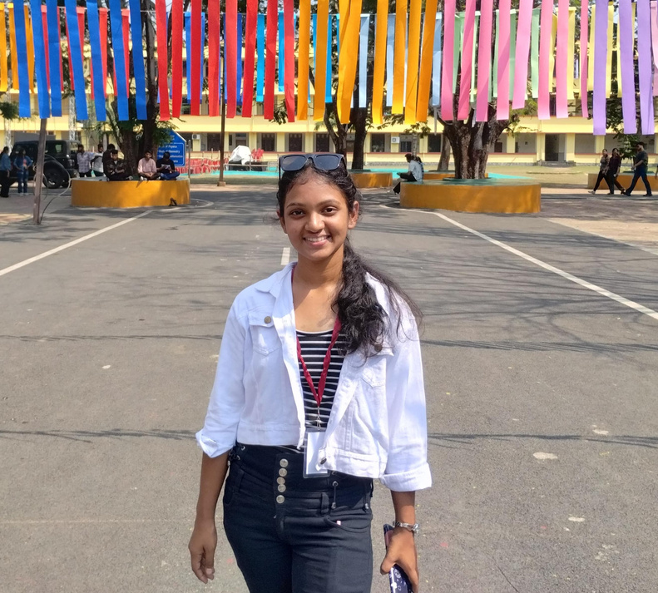
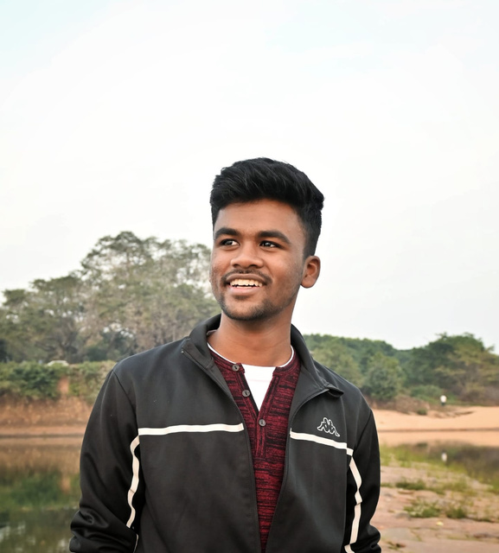
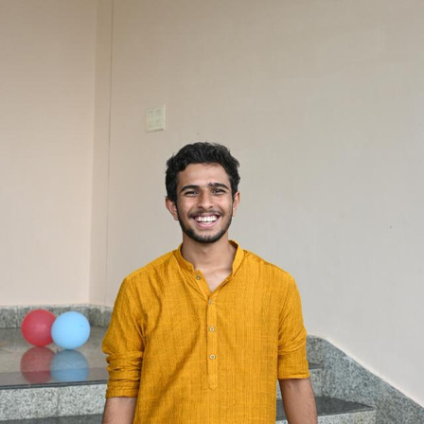
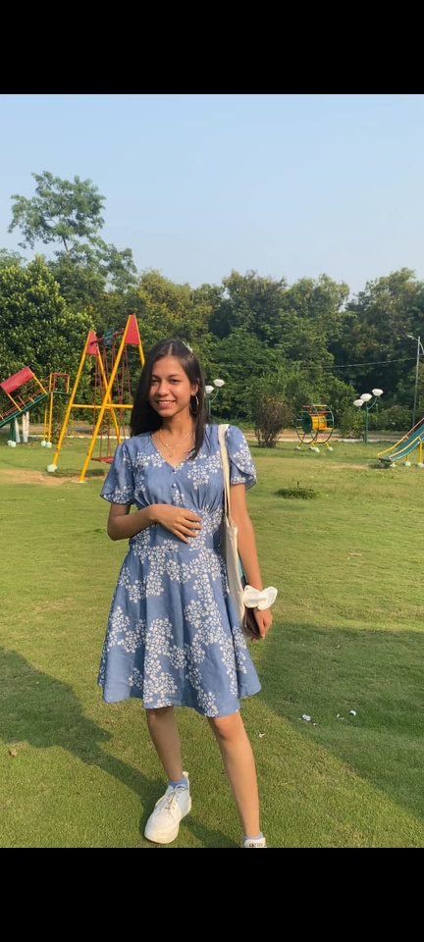
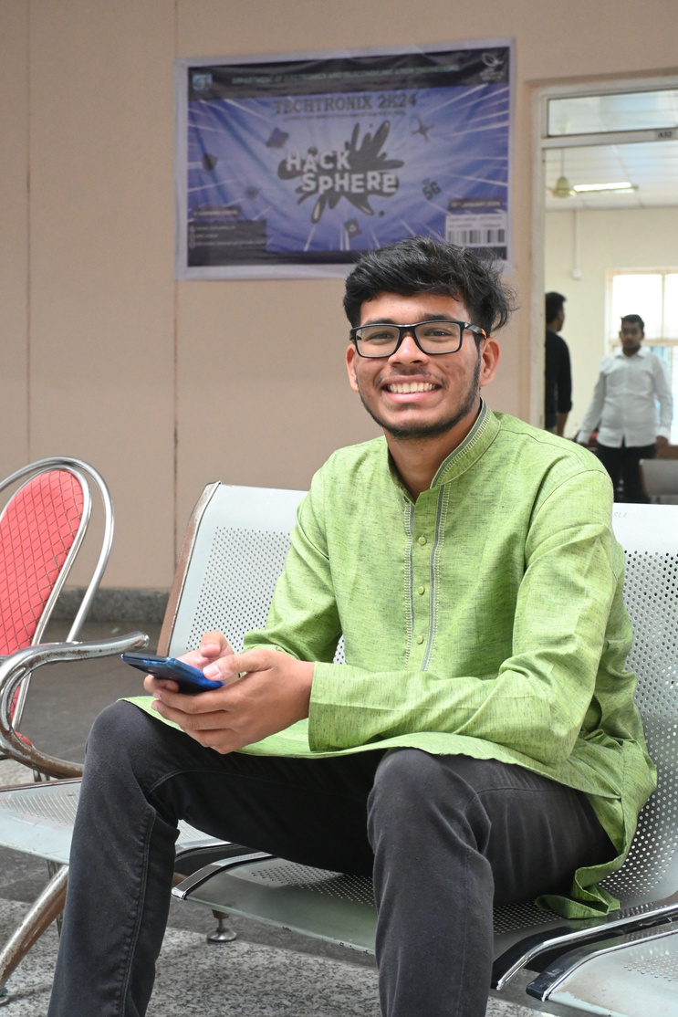
INTRODUCE YOUR TEAM
Frontend Dev-Swapnita
Singh
Backend Dev-Hardeep Mohanty
AI ML Dev-Kaushik Kumar Dash
UI/UX Designer-Priyadarshini Muduli
UI/UX Designer-Aumshuman Mohapatra
SUMMER HACK

Slide 3
PROBLEM STATEMENT:
Easy to customize AI agent builder.
SUMMER HACK

Slide 4
STACK YOU ARE PLANNING TO USE:
MERN Stack (MongoDB, Express, React, Node.js)
Python
SUMMER HACK

Slide 5
BLUEPRINT OF THE TOOL:
We're building a user-friendly AI agent creation tool that doesn't require coding. This means anyone can design agents to fit their needs, whether it's a single conversational agent or something more complex. The tool will handle various inputs including text, media like photos and videos, and even documents. You'll have flexibility in choosing the AI model that powers your agent, with options like GPT and Gemini. To control the conversation flow, you can leverage pre-built commands or create your own custom options. The application will be built with MERN (MongoDB, Express, React, Node.js) and Python.
SUMMER HACK

